Slide 1
A low cost Automated
Mosquito Trapping System
using Arduino
Batch – B2
Team Members
Aswin Raaj .R
Mani Balaji .S
Tharun .V.S
Guided by
Dr.G.Pandiaraj
Assistant Professor (Sl. Grade)
Electrical and Electronics Engineering

Slide 2
Objective
To trap mosquitoes using frequencies
To evaluate the effectiveness of frequencies in luring mosquitoes
To mitigate mosquitoes without using chemicals
To Ensure a non-toxic approach that minimizes health risks
Achieve long-term savings by potentially reducing the need for frequent purchases of chemical sprays

Slide 3
Motivation
Every year 360 million people get infected due to mosquito
To create innovative and effective mosquito control strategies using acoustic science
To address the need for eco-friendly pest control methods that do not harm non-target species
To provide a safer alternative without the toxic effects associated with chemicals.
https://www.worldmosquitoprogram.org/en/learn/mosquito-borne-diseases

Slide 4
Behaviour of Mosquito
Female mosquitoes - attract to the sounds produced by wingbeats of male mosquitoes and other frequencies present in their environment(250-650hz)
Tympanal Organs acts similar to ears and are sensitive to sound vibrations. Sensilla can detect vibrations and sound waves, which are critical for locating potential hosts.
In cooler conditions, mosquitoes may wander more as they search for warmer microhabitats or areas where hosts (e.g., humans or animals) are present
Study proved - mosquitoes can hear sound upto10 metres away
https://news.cornell.edu/stories/2019/02/study-mosquitoes-can-hear-10-meters-away

Slide 5
Mosquito species
Mosquito Species | Diseases Transmitted | Attractants | Active Season | Frequency
Aedes aegypti | - Dengue | - CO2 | - Monsoon season (June to Nov) | 300 – 600hz
 | - Chikungunya | - Body Heat | - Throughout warmer months
 | - Zika Virus | - Lactic Acid
Anopheles stephensi | - Malaria | - CO2 | - Throughout the year | 400 – 600hz
 |  | - Body Heat | - Peaks during rainy season
Table. Disease causing common mosquito species and their attracting frequency

Slide 6
Attractants
Carbon dioxide- produced in higher concentrations near a host, detected by nerve cells called cpA neurons present in antenna ,use this gas as a cue to locate potential hosts
Body heat - thermoreceptor on their antennae and mouthparts detect heat. The body temperature of mammals and birds is typically higher than the surrounding environment, making them easier targets.
Chemical attractants- Lactic acid and octenol found in human sweat and breath respectively is more effective attractant
Colours - dark colours in blue and purple spectrum attract mosquitoes.
Sound - frequency in range 250 Hz to 650 Hz mimic male wing beats
https://news.cornell.edu/stories/2019/02/study-mosquitoes-can-hear-10-meters-away

Slide 7
Tools Required
Arduino Uno
5V buzzer
UV led light 5mm (365nm – 400nm)
dc motor and fan
Cardboard
Connecting wires

Slide 8
How frequency attracts ?
Buzzer
Research shows - certain sound frequencies can significantly influence the movement patterns of mosquitoes, making sound - potentially effective tool for attraction
Belton, Peter. "Attraction of male mosquitoes to sound." J Am Mosquito Control Assoc 10 (1994): 297-301.

Slide 9
How UV attracts ?
Normally mosquitoes are attracted for any light in dark place. The lights in blue and violet spectrum will attract mosquito more effectively.
UV light generally produces warmth – primary attractant - mosquito

Slide 10
Block Diagram
UV
Suction Unit
Speaker
9V battery
5v Supply
Arduino UNO
microcontroller

Slide 11
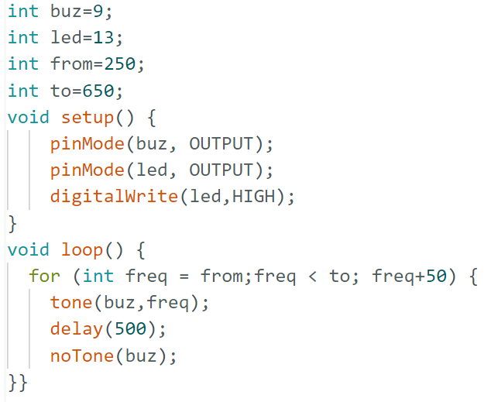
Arduino Code

Slide 12
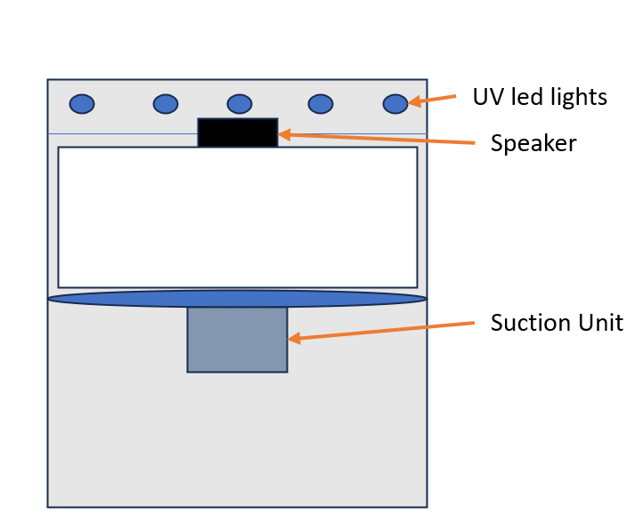
Prototype Design

Slide 13
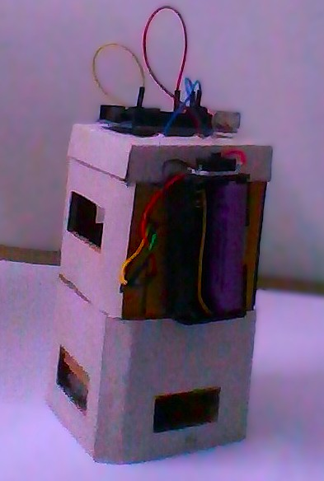
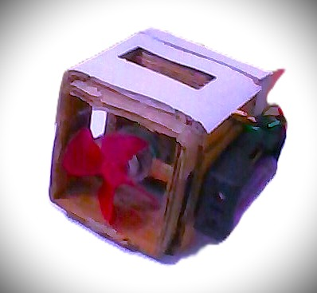
Prototype
Fig. Suction and frequency emitting unit

Slide 14
Advantages
Cost effective
Low maintenance
Health protection
Targeted attraction
Eco-Friendly solution
Reduced chemical exposure
User-Friendly technology

Slide 15
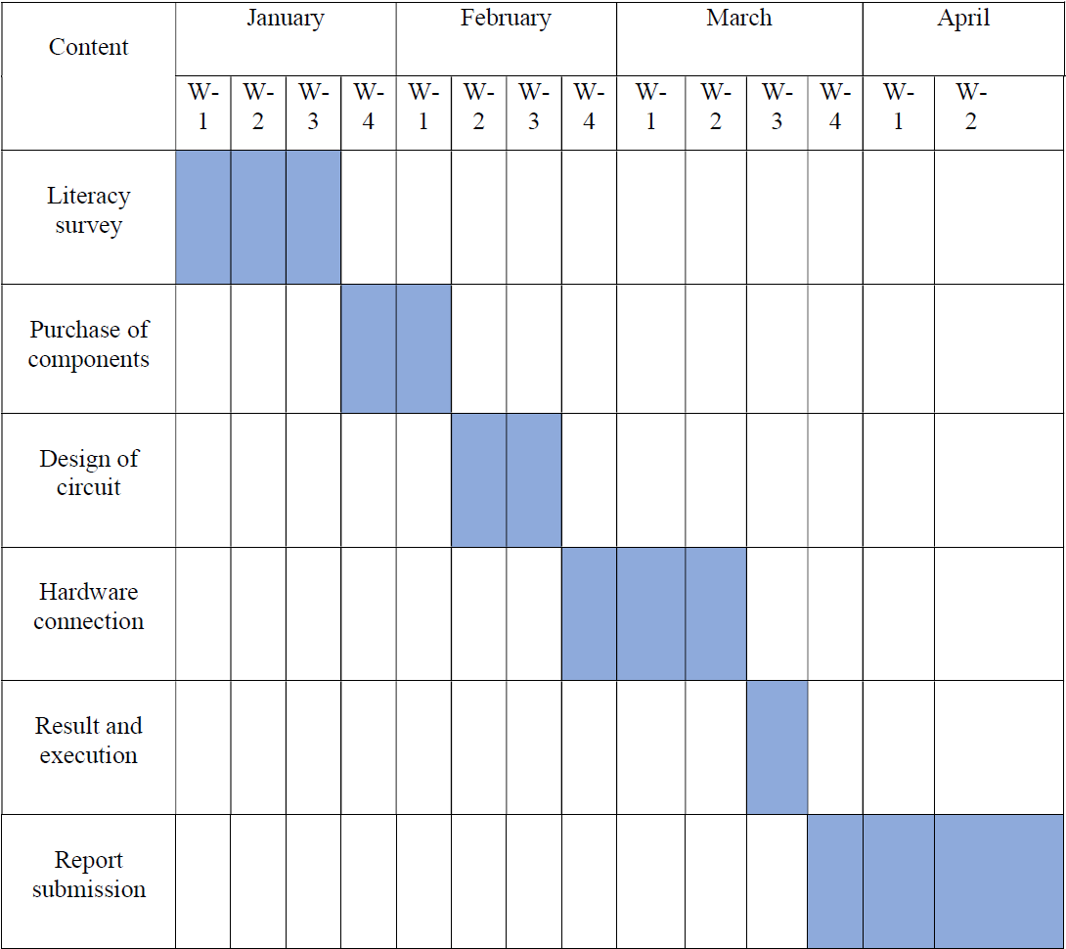
Gantt Chart

Slide 16
References
Kellogg, FE T., and R. H. Wright. "The guidance of flying insects. V. Mosquito attraction." The Canadian Entomologist 94.10 (1962): 1009-1016.
Brown, Anthony WA. "The attraction of mosquitoes to hosts." JAMA 196.3 (1966): 249-252.
Gopfert, Martin C., Hans Briegel, and Daniel Robert. "Mosquito hearing: sound-induced antennal vibrations in male and female Aedes aegypti." Journal of Experimental Biology 202.20 (1999): 2727-2738.
Belton, Peter. "Attraction of male mosquitoes to sound." J Am Mosquito Control Assoc 10 (1994): 297-301.

Slide 17
Thank You

